Slide 1

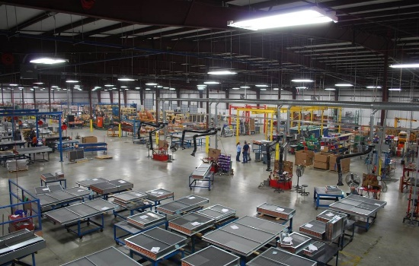
Industry Leader in the Replacement Coil
Business

Slide 2

OUR AREAS OF EXPERTISE
Replacement of any coil – regardless of age, make or construction
Expert system and coil failure analysis
Combination production and custom manufacturer providing countless arrangements and construction options
Guaranteed shipment programs - 3, 5 and 10 working days
Heavy duty designs for industrial process applications

Slide 3
REPLACEMENT OF ANY COIL, REGARDLESS OF AGE, MAKE OR CONSTRUCTION
1976 or 2016 - no matter - we have a replacement for your existing design
Many HVAC manufacturers are out of business or past unit designs are no longer available
OEM manufacturers charge outrageous prices and lead times for coil and other replacement components

Slide 4
REPLACEMENT OF ANY COIL, CONT.
Our library of knowledge (including, but not limited to) decreases the need for field measuring:
    Industry Designs
    Model Numbers
    Previously Built Coils
Example: 4 Row, 40” x 135” Coil for a Carrier 1975 Vintage Air Handle, Copper Fin, Stainless Steel Casing – We build and ship in 5 working days, and we most likely, know the dimensions.

Slide 5
EXPERT SYSTEM AND COIL FAILURE ANALYSIS
80% of all installed coils fail prematurely due to:
    Improper Design
    Incorrect Application
    Adverse Systematic Conditions
Field analysis by knowledgeable, local representatives across the country

Slide 6
EXPERT ANALYSIS CONT.
Written analysis reports directly from Capital Coil include:
    Specific Coil Failures
    Cause of Failure
    Corrective Action
Expert replacement quotes provide all applicable changes in coil design or construction that may create longevity in existing system

Slide 7
COMBINATION: PRODUCTION & CUSTOM DESIGN
Production prices with customized results
Almost every type of arrangement, including steam distributing, fluid, water, glycol, DX cooling, condenser and also multi-circuit, cleanable, same or opposite end and many, many more
Ten different fin patterns, 4 to 19 fins per inch, 6 different tube diameters and coil sizing from smallest to largest coils
Available alternative materials allow for customizing the coil design for the application desired

Slide 8
GUARANTEED QUICK-SHIP PROGRAM
Guaranteed or you don’t pay the expedited charge
Program good every working day of the year
1st working day is the day after complete order entry and includes same day credit check
Program includes 3, 5, & 10 day quick-ships
No variable delays due to paperwork
Coils are guaranteed to ship on or before the designated working day
99% of our shipments were met in 2015

Slide 9
HEAVY DUTY DESIGNS FOR INDUSTRIAL APPLICATIONS
High pressure, high temperature, air tight and cleanable designs available
Materials to include carbon steel, aluminum, copper, brass, admiralty brass, Cupro-nickel and stainless steel
Specific quality brazing, welding, testing and code stamps all available
Many designs and materials can be shipped in short lead times to meet planned company shutdowns or for emergency breakdowns

Slide 10
Unique & high quality coil selection program
Selects or rates all cooling and heating coils
Produces complete performance input and output data
Prices all coils
Provides applicable coil drawings for complete submittal
Variable drawing feature allows you to change specific coil casing and connection dimensions to customize your overall dimension requirements

Slide 11

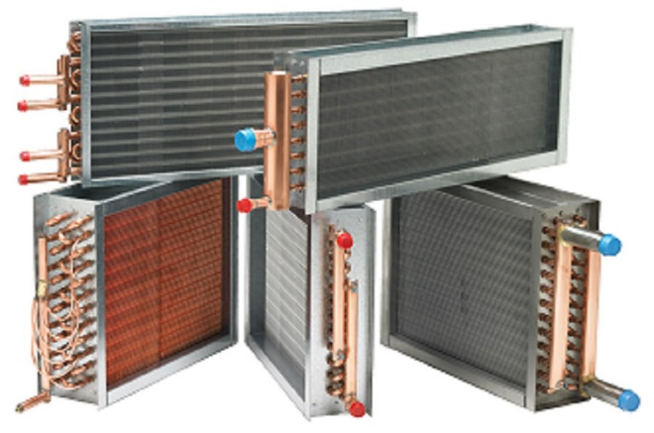
PRODUCT LINEUP
Phone: 484-498-8660 • Fax: 484-631-0558 • www.capitalcoil.com • sales@capitalcoil.com

Slide 12
Condenser Coil

Slide 13

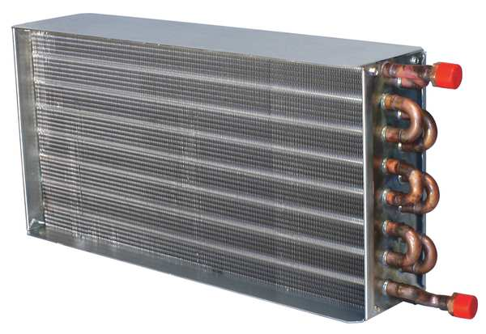
Booster Coil

Slide 14
Direct Expansion Cooling Coil

Slide 15

Steam Distributing

Slide 16
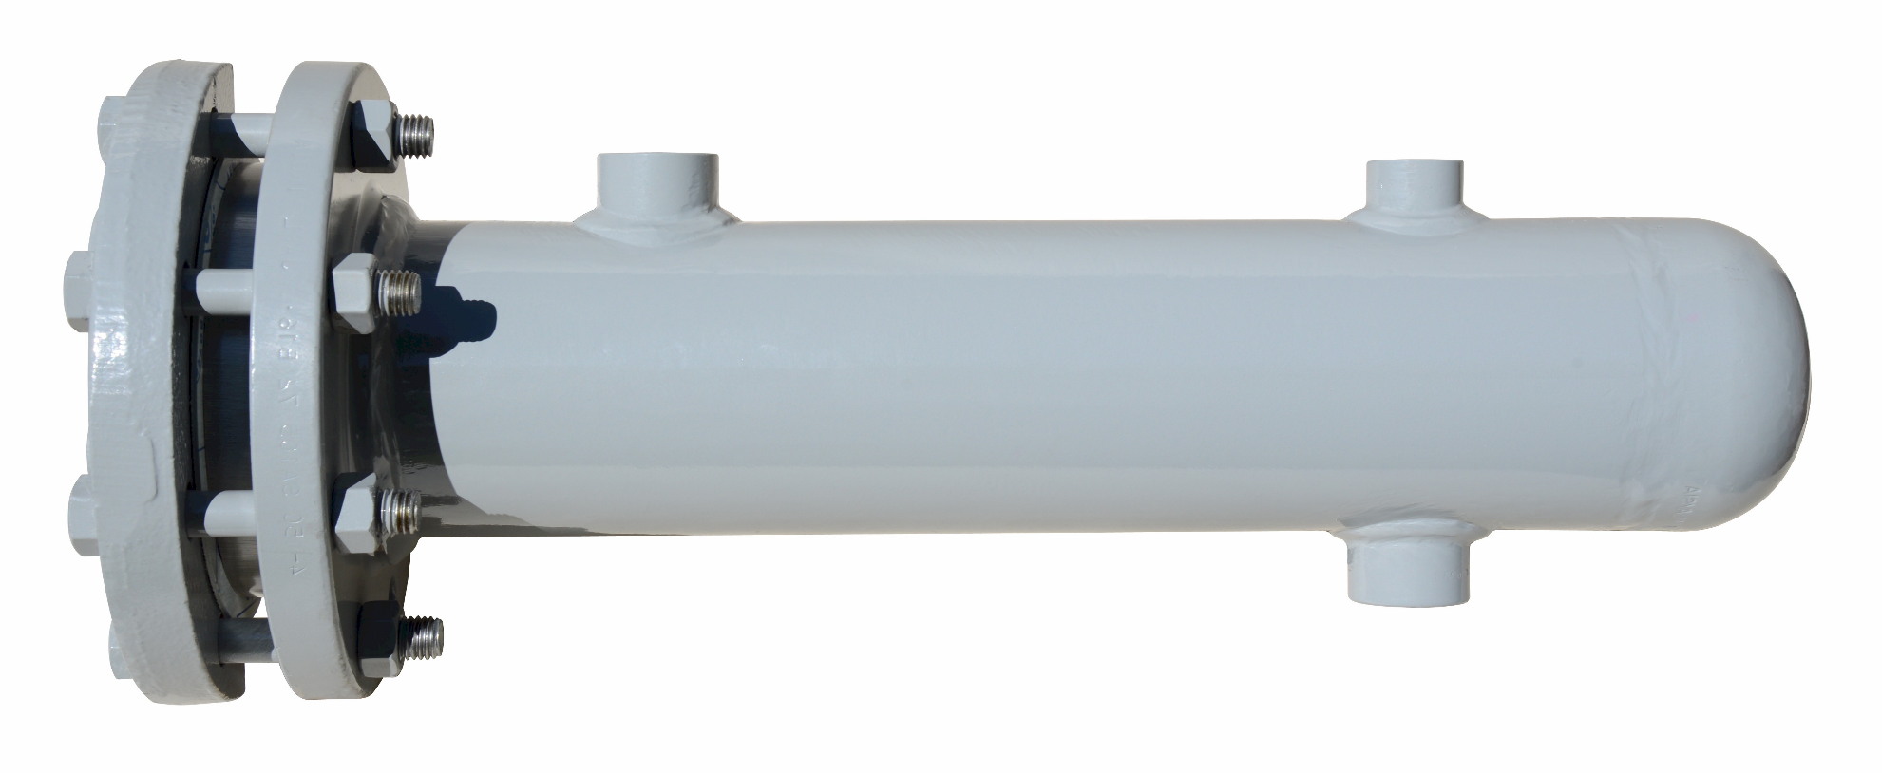
Heat Exchanger

Slide 17
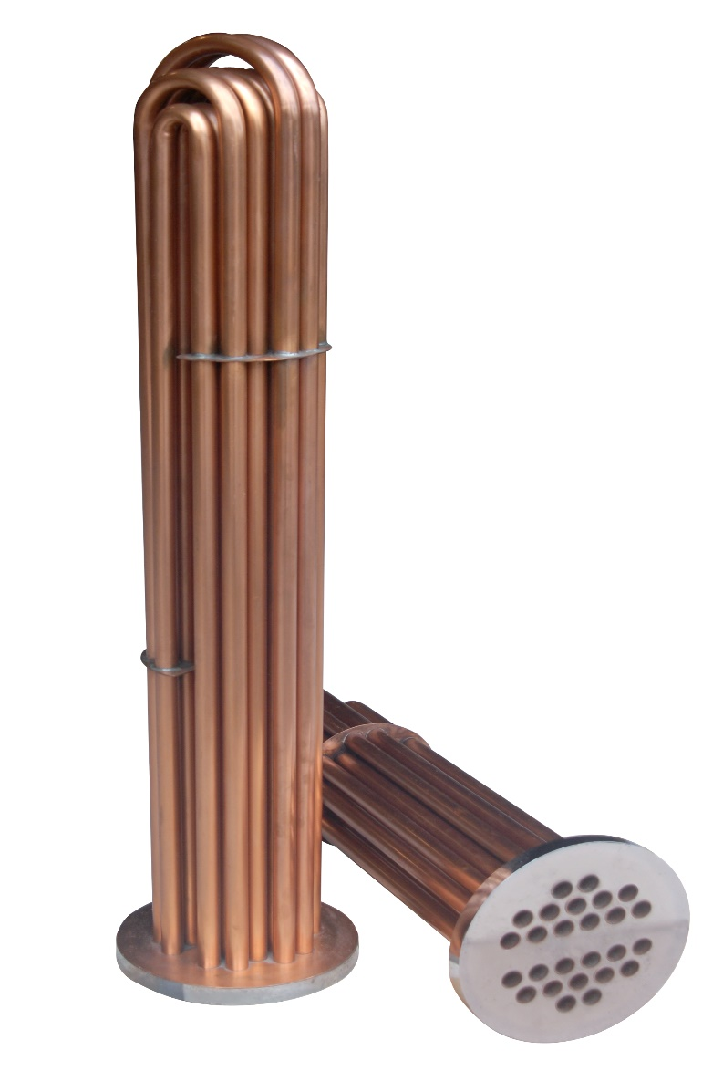
Tube Bundles

Slide 18
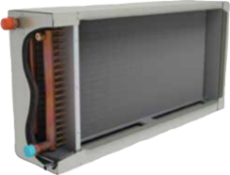
Coil Cabinet w/Drain Pan

Slide 19

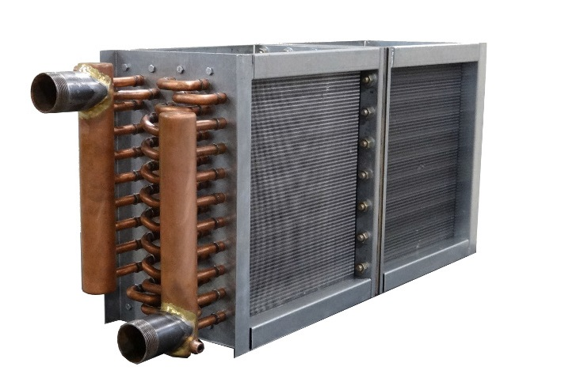
Divided Coils

Slide 20
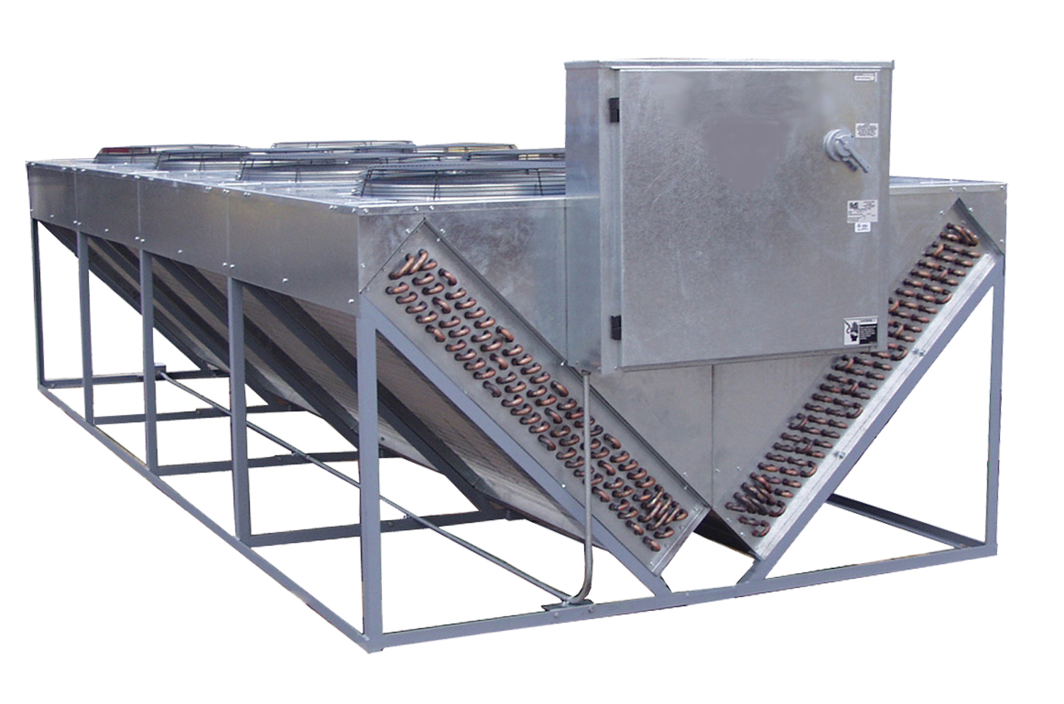
Fluid Coolers

Slide 21

Perfect Fit, Uncommonly Fast
Capital Coil & Air meets all your heating and coil needs. We are the industry leader, because
we are proactive about customer service.

